Slide 1
CEGE0096: Geospatial Programming
Lecture 8: Tree and Graph Representations
Dr. Aldo Lipani

Slide 2
Python Packages (So Far)
NumPy
Pandas
PyProj
Shapely
GeoPandas
Rasterio

Slide 3
The Modelling Process – Waterfall Model
Application Domain
1
Application Domain Model
2
initial
study
Conceptual
Model
Computational Models
3
system
analysis
Logical Model
4
system
design
Physical
Model
system
implementation
5

Slide 4
Vector and Raster Representations
Geospatial phenomena are modelled as either fields or features.
Fields and Features are modelled in a Geometric Space as Geometric entities.
Geometric entities (e.g. vector polygons or raster pixels) have a permanent spatial relationship.
We exploit this spatial relationship using spatial tools such as buffering, intersection, and overlay to solve problems.

Slide 5
Vector and Raster Representations (II)
However, these representations do not allow the spatial indexing of entities or to reason about how entities are connected to each other.
Which tube stations are a 5-minute walk from my current position?
How do I get from Euston Station to Waterloo Station?

Slide 6
Tree Representations

Slide 7
Tree Representation
A tree is a widely used data structure that simulates a hierarchical structure, with a root value and subtrees of children with a parent node represented as a set of linked nodes.
The root is the top node of the tree (like 1).
A child is a node directly connected to another node when moving away from the root (like 2 to 1).
A parent is the opposite of a child (like 1 to 2).
Siblings are nodes with the same parent (like 4, 5 and 6).
A descendant is a node reachable by repeated proceeding from parent to child (like 9 to 2).
An ancestor is a node reachable by repeated proceeding from the child to the parent (like 2 to 9).
A leaf is a node without children (like 4, 7, 9 and 3).
1
2
3
4
5
6
7
8
9

Slide 8
Binary Trees
A binary tree is a special tree where every node can only have two children.
This is commonly used as a binary search trees (BST), where for each node, a node’s left sub-tree must have values less than the node value and a node’s right sub-tree must have values greater than the node value.
BSTs (when balanced like B-Trees) allow a quicker search than storing values in a list. This is because at every node (decision point) we only need to check one of the two subtrees.
7
2
8
1
4
3
5
6

Slide 9
Basic Operations
Insert an element in a tree or create a tree if it is empty.
Search for an element in a tree.
Pre-order traversal traverse of a tree: the root node is visited first, then the left subtree is traversed, and the right subtree is traversed.
In-order traversal of a tree: the left subtree is traversed, then the root node is visited, and the right subtree is traversed.
Post-order traversal of a tree: the left subtree is traversed, then the right subtree is traversed, and the root node is visited.
N
L
R

Slide 10
R-Trees
R-trees are tree data structures used for spatial access methods, i.e., for indexing multi-dimensional information such as geographical coordinates, rectangles or polygons.
The key idea of the data structure is to group nearby objects and represent them within their minimum bounding rectangle.

Slide 11
Spatial Indexing
Indexing provides a method for quickly and efficiently finding objects in a data structure.
A spatial index provides a way for finding objects in a spatial data structure.
This is commonly done with R-trees.

Slide 12
Spatial Indexing with R-Trees
R-Tree indexing works by storing minimum bounding rectangle information in a spatial index.
A search can then be performed on a spatial index using a query rectangle in the form:
(min_x, min_y, max_x, max_y)
The index will then return a list of objects in the spatial index that intersect the query rectangle.

Slide 13
rtree

Slide 14
Rtree
Rtree is a Python package that provides a number of advanced spatial indexing features.
These include:
Multi-dimensional indexes
Intersection search
Nearest neighbour search
To use this library, we need to import the index object of rtree:
from rtree import index
Documentation available here: https://rtree.readthedocs.io/en/latest/

Slide 15
How to Use Rtree?
Let’s first create an index:
idx = index.Index()
Insert n-rectangles using the insert method of index:
idx.insert(1, (a_x_min, a_y_min, b_x_max, b_y_max), 'A')
We define a query as a rectangle:
q = (x_min, y_min, x_max, y_max)
To query the index, we use the intersection method of the index:
idx.intersection(q, objects = True)

Slide 16
Point Spatial Index
As well as rectangles, we can add a mix of points and rectangles to the spatial index:
points = [(0, 1), (2, 3), (4,-1)]
for n, point in enumerate(points): idx.insert(n, point, str(n))
Define a query: q = (q_x, q_y)
We can then perform a nearest neighbor search:
idx.nearest(q, num_results=1, objects=True)

Slide 17
Graph Representations

Slide 18
Graph Theory
Graph Theory is a field of mathematics that studies the behaviour of networks.
Graphs consist of nodes and edges.
Graphs can be used to model any kind of real-world network.

Slide 19
Network Modelling
In some situations, we are interested in interconnections.
Can I change from the Victoria Line to the Metropolitan Line at Warren Street?
Geospatial relationships do not communicate the information that we are interested in.
Graphs store connectivity information.

Slide 20
Network Modelling (II)

Slide 21
Network Modelling (III)
In transport networks:
Junctions are modelled by nodes.
Roads are modelled by edges.
Adjacency Matrix

Slide 22
Topological Adjacency
In Vector Modelling, lines and polygons are modelled as stand-alone entities (“spaghetti” representation).
We can use topological networks to model polygons:
Vertices are modelled by nodes;
Lines are modelled by edges.
Another topological network can be:
Polygons are modelled by nodes;
Boundaries are modelled by edges.

Slide 23
Examples of Modelling with Networks
Public Transport Network:
Underground stations are modelled by nodes;
Railway lines are modelled by edges.
Social Networks:
People are modelled by nodes;
Relationships are modelled by edges.

Slide 24
Graph Types

Slide 25
Graph
In a simple graph:
Nodes are unique;
Edges are undirected;
Edges are exclusively indexed by an undirected node tuple pair;
Tuple represents rows/columns in an adjacency matrix.
Only one edge can exist between two nodes:
Transport Network: traffic is two-way;
Social Network: We must be friends with each other.

Slide 26
Directed Graph (DiGraph)
In a directed graph:
Nodes are unique;
Edges are directed;
Edges are exclusively indexed by a directed node tuple pair;
Tuple represents rows/columns in an adjacency matrix.
One or two edges can exist between two nodes:
Transport Network: Traffic can either be two-way or one-way only.
Social Network: I can be your follower, but you don’t need to follow me.

Slide 27
MultiGraph
In a multigraph:
Nodes are unique;
Edges are undirected;
Edges are not exclusively indexed by node pairs; a unique key is required;
We can no longer use adjacency matrices (we need a bunch).
Transport Network: two nodes could be connected by a motorway and a local road.
Social Network: we can be friends and part of each other family members.

Slide 28
MultiDiGraph
In a MultiDiGraph:
Nodes are unique;
Edges are directed;
Edges are not exclusively indexed by node pairs, a unique key is required;
We can no longer use adjacency matrices (we need a bunch).
Transport Network: Two nodes connected by a motorway and a one-way street.
Social Network: two people can be friends and one can be among the closest friends of the other.

Slide 29
Graph Attributes
Attributes can be linked to edges and nodes:
Coordinate of the node;
Length of the road;
Geometry of road (e.g., LineString);
Classification of the road (e.g. Motorway);
Colour and line thickness for visualisation.

Slide 30
Weighted Graphs
Each graph edge can have a weight associated with it.
Weight represents impedance through graph:
E.g., edge length in a transport network.
But what happens if we have different speed limits in the transport network?
We can compute the total travel time by weighting each edge by a value equal to edge length divided by speed and then summing them up.

Slide 31
Shortest Path Algorithm
There are many algorithms for calculating the shortest distance through a graph network.
Different algorithms are suited for different graphs and have different computational time/memory efficiency.
A shortest-path algorithm is designed to minimise the cost of the path from a source node to a destination node.
Dijkstra’s shortest path algorithm is one of the most commonly used.

Slide 32
Dijkstra’s Algorithm
Dijkstra’s algorithm is a greedy algorithm for solving a single source shortest path that provides us with the shortest path from one particular source node to all other nodes in the given graph.
It can be applied to both directed and undirected graphs.
It is applied to weighted graphs.
For the algorithm to be applicable, the source and destination nodes must be connected.

Slide 33

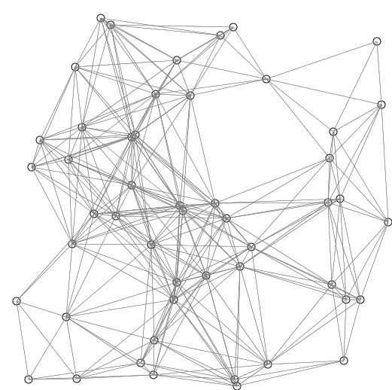
An Animated Example

Slide 34
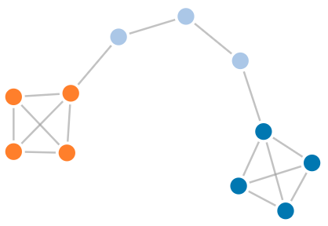
networkx

Slide 35
NetworkX
NetworkX is a Python package for the creation, manipulation, and study of the structure, dynamics and functions of complex networks.
This package is usually imported as:
import networkx as nx
Features:
Supports graphs, digraphs and multigraphs;
Many standard graph algorithms (like Dijkstra);
Edges can hold arbitrary data (e.g. weights, time-series).
Documentation available here: https://networkx.github.io/

Slide 36
Graph
To create a graph object:
g = nx.Graph()
To add nodes:
g.add_node(1, attribute='red')
To get the nodes:
g.nodes
To add an edge (note that we don’t need to add nodes first):
g.add_edge(1, 2, attribute='red')
To get the edges:
g.edges

Slide 37
Example
Let’s make a simple 3x3 Manhattan road network:
g = nx.Graph() w, h = 3, 3
We label our nodes in accordance with the formula defined by this function:
def get_id(r, c): return r + c * w
We now add the nodes to the graph:
for r in range(h): for c in range(w): g.add_node(get_id(r, c))

Slide 38
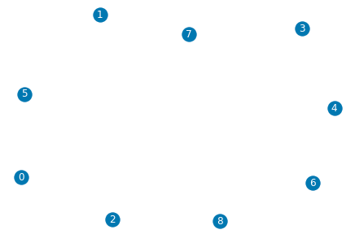
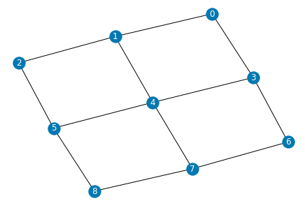
Example (II)
We can draw the graph by:
nx.draw(g, font_color='white', with_labels=True)
To construct the edges:
for r in range(h): for c in range(w): if c < w - 1: g.add_edge(get_id(r, c), get_id(r, c+1), length = 1.0) if r < h - 1: g.add_edge(get_id(r, c), get_id(r+1, c), length = 1.0)

Slide 39
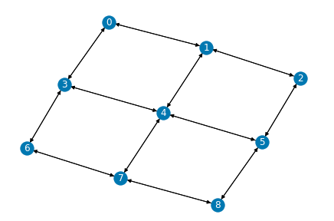
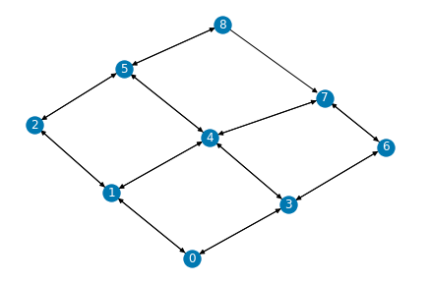
Example (III)
We can use Dijkstra to find the shortest path between two nodes:
nx.dijkstra_path(g, source=3, target=8, weight="length")
# [3, 6, 7, 8]
We can transform the graph into a DiGraph:
g = g.to_directed()
Let’s now remove one edge:
g.remove_edge(7, 8)
And, perform Dijkstra again:
# [3, 4, 5, 8]

